Slide 1
Memory Management
Virtual Memory Management
Lecture 9

Slide 2
Overview
Virtual Memory:
  Motivation
  Basic Idea
  Page Fault
Common application of Virtual Memory:
  Demand Paging
Aspects of virtual memory management:
  Page Table Structure
  Page Replacement Algorithms
  Frame Allocation

Slide 3
Virtual Memory: Motivation
Our last assumption of memory usage:
  Physical memory is large enough to hold one or more process logical memory space completely
This assumption is too restrictive:
  What if the logical memory space of process is >> then physical memory?
  What if the same program is executed on a computer with lesser physical memory?

Slide 4
Virtual Memory: Basic Idea
Observation:
  Secondary storage has much larger capacity compared to physical memory
Basic Idea:
  Split the logical address space into small chunks:
    Some chunks reside in physical memory
    Other are stored on secondary storage
The most popular approach:
  Extension of the paging scheme in last lecture:
    Logical memory space split into fixed size page
    Some pages may be in physical memory
    Other in secondary storage

Slide 5
Virtual Memory: Paging Illustration
Page 4
Page 0
Page 5
Page 1
Page 2
Page 3
Page 3
Page 0
Page 1
Page 4
Page 2
Page 5
Logical Memory Space
(Virtual Memory Space)
physical memory
Secondary Storage
Extension of basic paging scheme, i.e. the "virtual" part

Slide 6
Extended Paging Scheme
Basic idea remains unchanged:
  Use page table to translate virtual address to physical address
New addition:
  To distinguish between two page types
    memory resident (pages in physical memory)
    non-memory resident (pages in secondary storage)
    Use a (is memory resident?) bit in page table entry
  CPU can only access memory resident pages:
    Page Fault: When CPU tries to access non-memory resident page
    OS need to bring a non-memory resident page into physical memory

Slide 7
Accessing Page X: General Steps
Check page table:
  Is page X memory resident?
    Yes: Access physical memory location. Done.
    No: Continue to the next step
Page Fault: Trap to OS (OS is informed)
Locate page X in secondary storage
Load page X into a physical memory frame
Update page table
Go to step 1 to retry
By Hardware
By OS

Slide 8
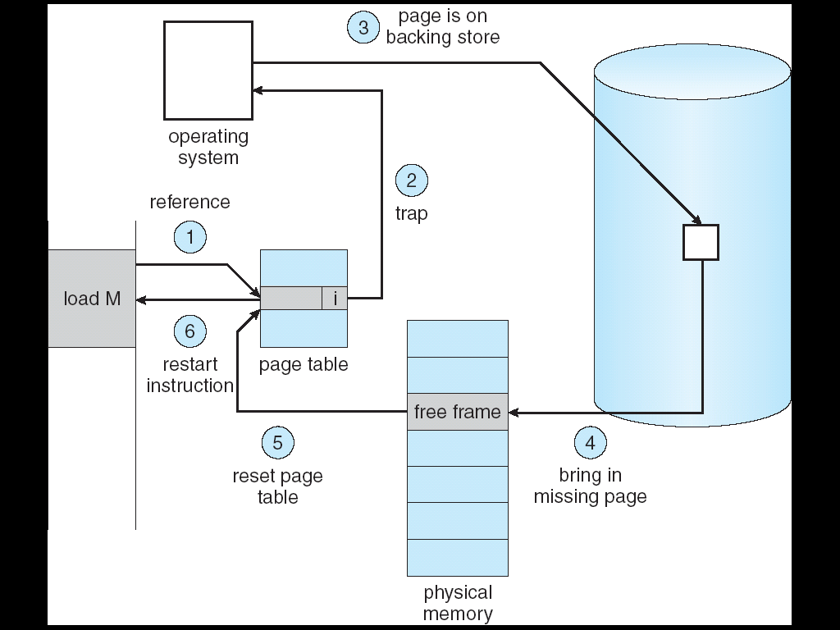
Virtual Memory Accessing: Illustration

Slide 9
Virtual Memory: Justification
Observation:
  Secondary Storage access time >> Physical memory access time
If memory access results in page fault most of the time:
  Non-memory resident pages need to be loaded
  Known as thrashing
How do we know that thrashing is unlikely to happen?
  Related: How do we know that after a page is loaded, it is likely to be useful for future accesses?

Slide 10
Recap: Locality Principles
Most programs exhibit these behaviors:
  Most time are spent on a relatively small part of code only
  In a period of time, accesses are made to a relatively small part of data only
Formalized as locality principles:
  Temporal Locality:
    Memory address which is used is likely to be used again
  Spatial Locality:
    Memory addresses close to a used address is likely to be used

Slide 11
Virtual Memory and Locality Principle
Exploiting Temporal Locality:
  After a page is loaded to physical memory, it is likely to be accessed in near future
    Cost of loading page is amortized
Exploiting Spatial Locality:
  A page contains contiguous locations that is likely to be accessed in near future
    Later access to nearby locations will not cause page fault
However, there are always exceptions ☺
  Programs that behave badly due to poor design or with malicious intention

Slide 12
Virtual Memory: Summary
Completely separate logical memory address from physical memory
  Amount of physical memory no longer restrict the size of logical memory address
More efficient use of physical memory
  Page currently not needed can be on secondary storage
Allow more processes to reside in memory
  Improve CPU utilization as there are more processes to choose to run

Slide 13
More on Virtual Memory Management
More in-depth looks on several aspects:
  Huge page table with large logical memory space ➔ How to structure the page table for efficiency?
    Page Table Structures
  Each process has limited number of resident memory pages
  ➔ Which page should be replaced when needed?
    Page Replacement Algorithms
  Limited physical memory frames
  ➔ How to distribute among the processes?
    Frame Allocation Policies

Slide 14
Page Table Structure
Waste not, want not

Slide 15
Page Table Structure
Page table information is kept with the process information and takes up physical memory space
Modern computer systems provide huge logical memory space
  4GiB(32bit) is the norm, 8TiB or more is possible now
  Huge logical memory space ➔ Huge number of pages
  Each page has a page table entry ➔ Huge page table
Problems with huge page table
  High overhead
  Fragmented page table:
    Page table occupies several memory pages

Slide 16
Page Table Structure: Direct Paging
Direct Paging: keep all entries in a single table
With 2^{p} pages in logical memory space
  p bits to specify one unique page
  2^{p} page table entries (PTE), each contains:
    physical frame number
    additional information bits (valid/invalid, access right etc)
Example:
  Virtual Address: 32 bits, Page Size = 4KiB
  P = 32 – 12 = 20
  Size of PTE = 2 bytes
  Page Table Size = 2²⁰ * 2 bytes = 2MiB (!)

Slide 17
2-Level Paging: Basic Idea
Observation:
  Not all process uses the full range of virtual memory space ➔ Full page table is a waste!
Basic Idea:
  Split the full page table into regions
  Only a few regions are used
    As memory usage grows, new region can be allocated
  This idea is similar to split logical memory space into pages ☺
  Need a directory to keep track of the regions
    Analogues of page table ⬅➔ pages

Slide 18
2-Level Paging: Description
Split page table into smaller page tables
  Each with a page table number
If the original page table has 2^{P} entries:
  With 2^{M} smaller page tables, M bits is needed to uniquely identify one page table
  Each smaller page table contains 2^{(P-M)} entries
To keep track of the smaller page tables
  A single page directory is needed
  Page directory contains 2^{M} indices to locate each of the smaller page table

Slide 19
2-level Paging: Illustration
virtual address
page dir #
page #
offset
page table
page directory
page directory
base register
.
.
.
frame #
offset
physical address
.
.
.

Slide 20
2-Level Paging: Advantages
We can have empty entries in the page directory
  The corresponding page tables need not be allocated!
Using the same setting as the previous example:
  Assume only 3 page tables is in used
  Overhead = 1 page directory + 3 smaller page tables
2¹¹ entries
Page Tables
Overhead
= 3 x (2¹¹ x 2) = 12KiB
2¹¹ entries
Page Directory
2²⁰ / 2¹¹ = 2⁹ entries
Overhead
= 2⁹ x 2 = 1KiB
2¹¹ entries
Empty
Empty
Total Overhead
= 1KiB + 12KiB =13KiB

Slide 21
Inverted Page Table: Basic Idea
Page table is a per-process information
  With M processes in memory, there are M independent page tables
Observation:
  Only N physical memory frames can be occupied
  Out of the M page tables, only N entries is valid
  Huge waste: N << Overhead of M page tables
Idea:
  Keep a single mapping of physical frame to <pid, page#>
    pid = process id , page# = page number
    page# is not unique among processes
    pid + page# can uniquely identify a memory page

Slide 22
Inverted Page Table: Basic Idea (cont)
In normal page table, the entries are ordered by page number
  To lookup page X, simply access the Xth entry
In inverted page table, the entries are ordered by frame number
  To lookup page X, need to search the whole table
Advantage:
  Huge saving: One table for all processes
Disadvantage:
  Slow translation

Slide 23
Inverted Table: Illustration
Physical Memory
CPU
PID
P
D
i
D
i
PID
P
Inverted Page Table
Notes:
P change to Pg

Slide 24
Page Replacement Algorithms
Who should I kick out next?

Slide 25
Page Replacement Algorithms
Suppose there is no free physical memory frame during a page fault:
  Need to evict (free) a memory page
When a page is evicted:
  Clean page: not modified ➔ no need to write back
  Dirty page: modified ➔ need to write back
Algorithms to find a suitable replacement page
  Optimum (OPT)
  FIFO
  Least Recently Used
  Second-Chance (Clock)
  etc…

Slide 26
Modeling Memory References
In actual memory reference:
  Logical Address = Page Number + Offset
However, to study the page replacement algorithm
  Only page number is important
➔ To simplify discussion, memory references are often modeled as memory reference strings, i.e. a sequence of page numbers

Slide 27
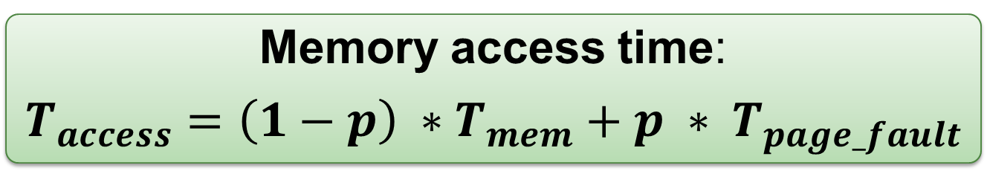
Page Replacement Algorithms: Evaluation
Memory access time:
$$T_{access}=\left(1−p\right) ∗T_{mem}+p ∗ T_{page_fault}$$
  𝒑 = probability of page fault
  T_{mem} = access time for memory resident page
  T_{page_fault} = access time if page fault occurs
Since T_{page_fault} >> T_{mem}
  Need to reduce p to keep T_{access} reasonable
See for yourself, try to find 𝒑 if:
  T_{mem} = 100ns, T_{page_fault} = 10ms, T_{access} = 120ns
Good algorithm should reduce the total number of page faults

Slide 28
Optimal Page Replacement (OPT)
General Idea:
  Replace the page that will not be used again for the longest period of time
  Guarantees minimum number of page faults
Unfortunately, not realizable:
  Need future knowledge of memory references
Still useful:
  As a base of comparison for other algorithms
  The closer to OPT == better algorithm

Slide 29
Example: OPT (6 Page Faults)
Time | Memory Reference | Frame |  |  | Next Use Time |  |  | Fault?
 |  | A | B | C
1 | 2 | 2 |  |  | 3 | ◎ | ◎ | Y
2 | 3 | 2 | 3 |  | 3 | 9 | ◎ | Y
3 | 2 | 2 | 3 |  | 6 | 9 | ◎
4 | 1 | 2 | 3 | 1 | 6 | 9 | ◎ | Y
5 | 5 | 2 | 3 | 5 | 6 | 9 | 8 | Y
6 | 2 | 2 | 3 | 5 | 10 | 9 | 8
7 | 4 | 4 | 3 | 5 | ◎ | 9 | 8 | Y
8 | 5 | 4 | 3 | 5 | ◎ | 9 | 11
9 | 3 | 4 | 3 | 5 | ◎ | ◎ | 11
10 | 2 | 2 | 3 | 5 | 12 | ◎ | 11 | Y
11 | 5 | 2 | 3 | 5 | ◎ | ◎ | 11
12 | 2 | 2 | 3 | 5 | ◎ | ◎ | ◎

Slide 30
FIFO Page Replacement Algorithm
General Idea:
  Memory pages are evicted based on their loading time
  Evict the oldest memory page
Implementation:
  OS maintain a queue of resident page numbers
    Remove the first page in queue if replacement is needed
    Update the queue during page fault trap
  Simple to implement
    No hardware support needed

Slide 31
Example: FIFO (9 Page Faults)
Time | Memory Reference | Frame |  |  | Loaded at Time |  |  | Fault?
 |  | A | B | C
1 | 2 | 2 |  |  | 1 |  |  | Y
2 | 3 | 2 | 3 |  | 1 | 2 |  | Y
3 | 2 | 2 | 3 |  | 1 | 2
4 | 1 | 2 | 3 | 1 | 1 | 2 | 4 | Y
5 | 5 | 5 | 3 | 1 | 5 | 2 | 4 | Y
6 | 2 | 5 | 2 | 1 | 5 | 6 | 4 | Y
7 | 4 | 5 | 2 | 4 | 5 | 6 | 7 | Y
8 | 5 | 5 | 2 | 4 | 5 | 6 | 7
9 | 3 | 3 | 2 | 4 | 9 | 6 | 7 | Y
10 | 2 | 3 | 2 | 4 | 9 | 6 | 7
11 | 5 | 3 | 5 | 4 | 9 | 11 | 7 | Y
12 | 2 | 3 | 5 | 2 | 9 | 11 | 12 | Y

Slide 32
FIFO: Problems
If physical frame increases (e.g. more RAM)
  The number page fault should decrease
FIFO violates this simple intuition!
  Use 3 / 4 frames to try: 1 2 3 4 1 2 5 1 2 3 4 5
Opposite behavior (↑ frames ➔ ↑ page faults)
  Known as Belady's Anomaly
Reason:
  FIFO does not exploit temporal locality

Slide 33
Least Recently Used Page Replacement (LRU)
General Idea:
  Make use of temporal locality:
    Replace the page that has not been used in the longest time
  Expect a page to be reused in a short time window
    Have not used for some time ➔ most likely will not be used again
Notes:
  Attempts to approximate the OPT algorithm
    Gives good results generally
  Does not suffer from Belady's Anomaly

Slide 34
Example: LRU (7 Page Faults)
Time | Memory Reference | Frame |  |  | Last Use Time |  |  | Fault?
 |  | A | B | C
1 | 2 | 2 |  |  | 1 |  |  | Y
2 | 3 | 2 | 3 |  | 1 | 2 |  | Y
3 | 2 | 2 | 3 |  | 3 | 2
4 | 1 | 2 | 3 | 1 | 3 | 2 | 4 | Y
5 | 5 | 2 | 5 | 1 | 3 | 5 | 4 | Y
6 | 2 | 2 | 5 | 1 | 6 | 5 | 4
7 | 4 | 2 | 5 | 4 | 6 | 5 | 7 | Y
8 | 5 | 2 | 5 | 4 | 6 | 8 | 7
9 | 3 | 3 | 5 | 4 | 9 | 8 | 7 | Y
10 | 2 | 3 | 5 | 2 | 9 | 8 | 10 | Y
11 | 5 | 3 | 5 | 2 | 9 | 11 | 10
12 | 2 | 3 | 5 | 2 | 9 | 11 | 12

Slide 35
LRU: Implementation Details
Implementing LRU is not easy:
  Need to keep track of the "last access time" somehow
  Need substantial hardware support
Approach A - Use a Counter:
  A logical "time" counters, which is incremented for every memory reference
  Page table entry has a "time-of-use" field
    Store the time counter value whenever reference occurs
    Replace the page with smallest "time-of-use"
  Problems:
    Need to search through all pages
    "Time-of-use" is forever increasing (overflow possible!)

Slide 36
LRU: Implementation Details (cont)
Approach B - Use a "Stack":
  Maintain a stack of page numbers
  If page X is referenced
    Remove from the stack (for existing entry)
    Push on top of stack
  Replace the page at the bottom of stack
    No need to search through all entries
  Problems:
    Not a pure stack: Entries can be removed from any where in the stack
    Hard to implement in hardware

Slide 37
Second-Chance Page Replacement (CLOCK)
General Idea:
  Modified FIFO to give a second chance to pages that are accessed
  Each PTE now maintains a "reference bit":
    1 = Accessed, 0 = Not accessed
  Algorithm:
    The oldest FIFO page is selected
    If reference bit == 0 ➔ Page is replaced
    If reference bit == 1 ➔ Page is given a 2nd chance
      Reference bit cleared to 0
      Arrival time reset ➔ page taken as newly loaded
      Next FIFO page is selected, go to Step 2
  Degenerate into FIFO algorithm
    When all pages has reference bit == 1

Slide 38
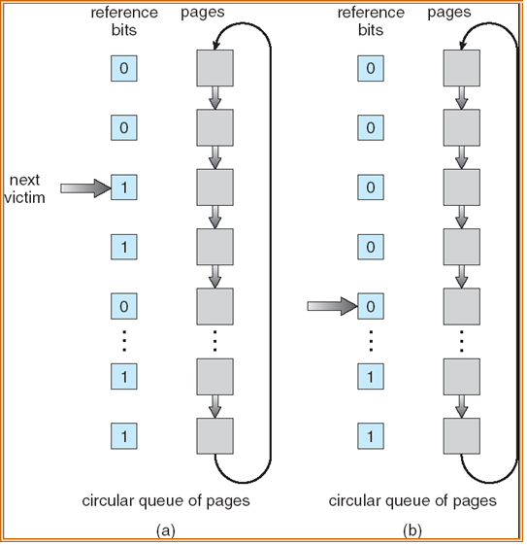
Second-Chance: Implementation Details
Use circular queue to maintain the pages:
  With a pointer pointing to the oldest page ( the victim page )
To find a page to be replaced:
  Advance until a page with '0' reference bit
  Clear the reference bit as pointer passes through

Slide 39
Example: CLOCK( 6 Page Faults )
Time | Memory Reference | Frame (with Ref Bit) |  |  | Fault?
 |  | A | B | C
1 | 2 | ►2 (0) |  |  | Y
2 | 3 | ►2 (0) | 3 (0) |  | Y
3 | 2 | ►2 (1) | 3 (0)
4 | 1 | ►2 (1) | 3 (0) | 1 (0) | Y
5 | 5 | 2 (0) | 5 (0) | ►1 (0) | Y
6 | 2 | 2 (1) | 5 (0) | ►1 (0)
7 | 4 | ►2 (1) | 5 (0) | 4 (0) | Y
8 | 5 | ►2 (1) | 5 (1) | 4 (0)
9 | 3 | 2 (0) | 5 (0) | ►3 (0) | Y
10 | 2 | 2 (1) | 5 (0) | ►3 (0)
11 | 5 | 2 (1) | 5 (1) | ►3 (0)
12 | 2 | 2 (1) | 5 (1) | ►3 (0)
► Victim Page

Slide 40
Frame Allocation
Which process should I favor?

Slide 41
Frame Allocation
Consider:
  There are N physical memory frames
  There are M processes competing for frames
  What is the best way to distribute the N frames among M processes?
Simple Approaches:
  Equal Allocation:
    Each process get N / M frames
  Proportional Allocation:
    Processes are different in size (memory usage)
    Let size_{p} = size of process p, size_{total} = total size of all processes
    Each process get size_{p}/size_{total}*N frames

Slide 42
Frame Allocation and Page Replacement
The implicit assumption for page replacement algorithms discussed:
  Victim page are selected among pages of the process that causes page fault
  Known as local replacement
If victim page can be chosen among all physical frames:
  Process P can take a frame from Process Q by evicting Q's frame during replacement!
  Known as global replacement

Slide 43
Local vs Global Replacement
Local Replacement:
  Pros:
    Frames allocated to a process remain constant ➔ Performance is stable between multiple runs
  Cons:
    If frame allocated is not enough ➔ hinder the progress of a process
Global Replacement:
  Pros:
    Allow self-adjustment between processes
      Process that needs more frame can get from other
  Cons:
    Badly behave process can affect others
    Frames allocated to a process can be different from run to run

Slide 44
Frame Allocation and Thrashing
Insufficient physical frame ➔ Thrashing in process
  Heavy I/O to bring non-resident pages into RAM
Hard to find the right number of frames:
  If global replacement is used:
    A thrashing process "steals" page from other process
    cause other process to thrashing (Cascading Thrashing)
  If local replacement is used:
    Thrashing can be limited to one process
    But that single process can hog the I/O and degrades the performance of other processes

Slide 45
Finding the right number of frames…
Observation:
  The set of pages referenced by a process is relatively constant in a period of time
    Known as locality
  However, as time passes, the set of pages can change
Example:
  When a function is executing, the references are likely on:
    local variables, parameters, code in that function
    these pages define the locality for the function
  After the function terminates, the references will changes to another set of pages

Slide 46
Working Set Model
Using the observation on locality:
  In a new locality:
    A process will cause page fault for the set of pages
  With the set of pages in frame:
    No/few page fault until process transits to new locality
Working Set Model:
  Defines Working Set Window Δ
    An interval of time
  W(t,Δ) = active pages in the interval at time t
  Allocate enough frames for pages in W(t, Δ) to reduce possibility of page fault

Slide 47
Working Set Model: Illustration
working set size
transient region:
working set changing
in size
stable region:
working set about the
same for a long time
time
transient
stable
Accuracy of working set model is directly affected by the choice of Δ
  Too small: May miss pages in the current locality
  Too big: May contains pages from different locality

Slide 48
Working Set Model: Illustration
Example memory reference strings
… | 2 | 6 | 5 | 7 | 1 | 1 | 2 | 7 | 5 | 6 | 3 | 4 | 4 | 4 | 3 | 5 | 3 | …
Δ
Δ
t1
t2
Assume
  Δ = an interval of 5 memory references
W(t1,Δ)={1,2,5,6,7} (5 frames needed)
W(t2,Δ)={3,4} (2 frames needed)
Try using different Δ values

Slide 49
Summary
Virtual memory
  The "why" and "how"
Discussed different aspects of virtual memory management
  Use different page table structure to reduce page table overhead
  Use different page replacement algorithms to reduce page fault
  How frame allocation affects page fault of a process

